Slide 1


Microprocessors and Assembly Language Spring 2020
Hamed Farbeh
farbeh@aut.ac.ir
Department of Computer Engineering
Amirkabir University of Technology
Lecture 20

Slide 2
Copyright Notice
Parts (text & figures) of this lecture are adopted from:
Arm Assembly Language Programming and Architecture, Volume 1, 1st edition, Muhammad Ali Mazidi, Sarmad Naimi, and Sepehr Naimi, MicroDigitalEd, 2013.
Microprocessors and Assembly Language, Spring 2020, AUT, Tehran, Iran

Slide 3
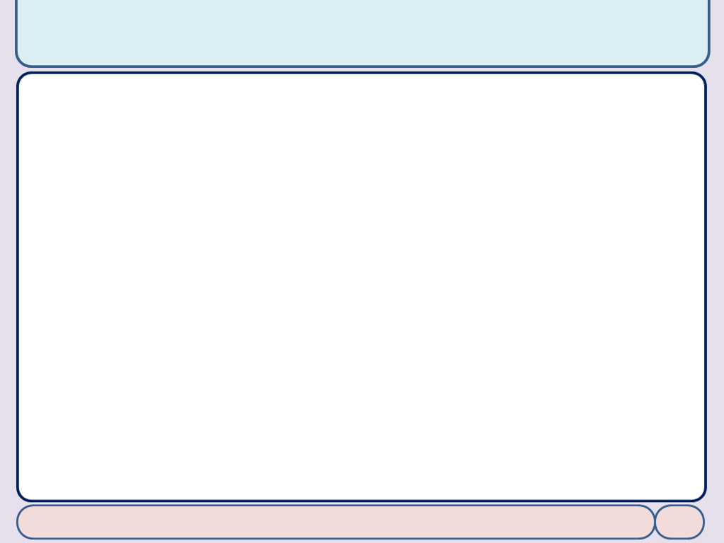
Branch, Call, and Looping in ARM
Microprocessors and Assembly Language, Spring 2020, AUT, Tehran, Iran

Slide 4
Looping in ARM
Using instruction BNE for looping
BACK ......... ; start of the loop ......... ; body of the loop ......... ; body of the loop SUBS Rn, Rn, #1 ; Rn = Rn - 1, set the flag Z = 1 if Rn = 0 BNE BACK ; branch if Z = 0
; --- this program adds value 9 to the R0 a 1000 times ---
AREA EXAMPLE4_1, CODE, READONLY
LDR R2, =1000 ; R2 = 1000 (decimal) for counter
MOV R0, #0 ; R0 = 0 (sum)
AGAIN ADD R0, R0, #9 ; R0 = R0 + 9 (add 09 to R1, R1 = sum)
SUBS R2, R2, #1 ; Decrement counter and set the flags.
BNE AGAIN ; repeat until COUNT = 0 (when Z = 1)
MOV R4, R0 ; store the sum in R4
HERE B HERE ; stay here
END
Microprocessors and Assembly Language, Spring 2020, AUT, Tehran, Iran

Slide 5
Looping in ARM
Loop inside a loop
AREA EXAMPLE4_3, CODE, READONLY
MOV R0, #0x55 ; R0 = 0x55
MOV R2, #16 ; load 16 into R2 (outer loop count)
L1 LDR R1, =1000000000 ; R1 = 1,000,000,000 (inner loop count)
L2 EOR R0, R0, #0xFF ; complement R0 (R0 = R0 Ex-OR 0xFF)
SUBS R1, R1, #1 ; R1 = R1 – 1, decrement R1 (inner loop)
BNE L2 ; repeat it until R1 = 0
SUBS R2, R2, #1 ; R2 = R2 – 1, decrement R2 (outer loop)
BNE L1 ; repeat it until R2 = 0
HERE B HERE ; stay here
END
Microprocessors and Assembly Language, Spring 2020, AUT, Tehran, Iran

Slide 6
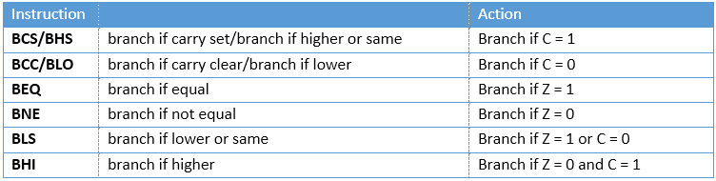
Looping in ARM
Conditional Branch Instructions for Unsigned Data
Microprocessors and Assembly Language, Spring 2020, AUT, Tehran, Iran

Slide 7
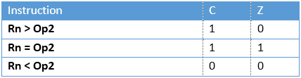
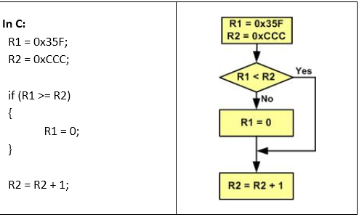
Looping in ARM
Comparison of unsigned numbers
CMP Rn, Op2
LDR R1, =0x35F ; R1 = 0x35F
LDR R2, =0xCCC ; R2 = 0xCCC
CMP R1, R2 ; compare 0x35F with 0xCCC
BCC OVER ; branch if C = 0
MOV R1, #0 ; if C = 1, then clear R1
OVER ADD R2, R2, #1
; R2 = R2 + 1 = 0xCCC + 1 = 0xCCD
Microprocessors and Assembly Language, Spring 2020, AUT, Tehran, Iran

Slide 8
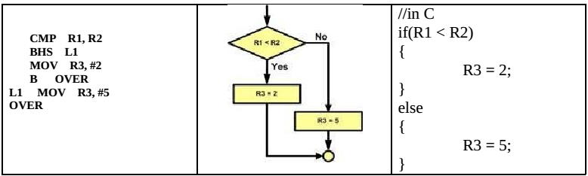
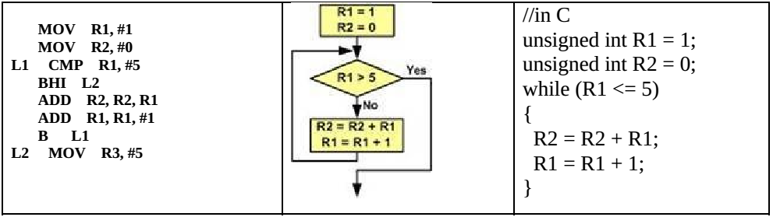
Branch Instruction
Microprocessors and Assembly Language, Spring 2020, AUT, Tehran, Iran

Slide 9
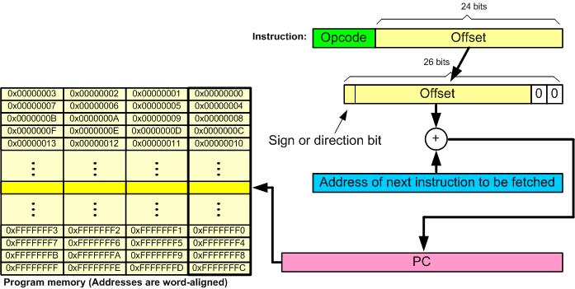
Branch Instruction
Microprocessors and Assembly Language, Spring 2020, AUT, Tehran, Iran

Slide 10
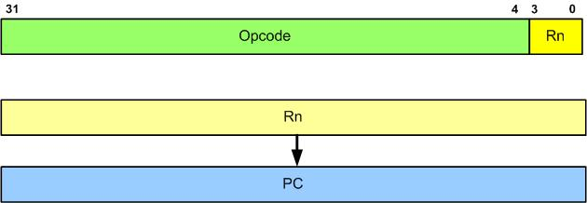
Branching beyond 32MB byte limit
Branch and exchange
BX Rn
Microprocessors and Assembly Language, Spring 2020, AUT, Tehran, Iran

Slide 11
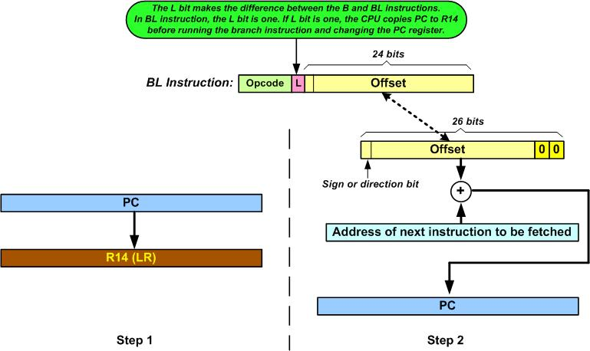
Calling Subroutine with BL
BL: Branch and Link
Microprocessors and Assembly Language, Spring 2020, AUT, Tehran, Iran

Slide 12
Calling Subroutine with BL
Delay subroutine
AREA EXAMPLE4_8, CODE, READONLY
RAM_ADDR EQU 0x40000000 ; change the address for your ARM
LDR R1, =RAM_ADDR ; R1 = RAM address
AGAIN MOV R0, #0x55 ; R0 = 0x55
STRB R0, [R1] ; send it to RAM
BL DELAY ; call delay (R14 = PC of next instruction)
MOV R0, #0xAA ; R0 = 0xAA
STRB R0, [R1] ; send it to RAM
BL DELAY ; call delay
B AGAIN ; keep doing it
; --------------------DELAY SUBROUTINE
DELAY LDR R3, =5 ; R3 =5, modify this value for different delay
L1 SUBS R3, R3, #1 ; R3 = R3 - 1
BNE L1
BX LR ; return to caller; --------------------end of DELAY subroutine
END ; notice the place for END directive
Microprocessors and Assembly Language, Spring 2020, AUT, Tehran, Iran

Slide 13
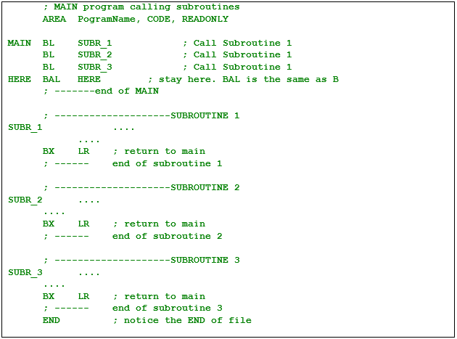
Main Program and Calling Subroutines
Microprocessors and Assembly Language, Spring 2020, AUT, Tehran, Iran

Slide 14

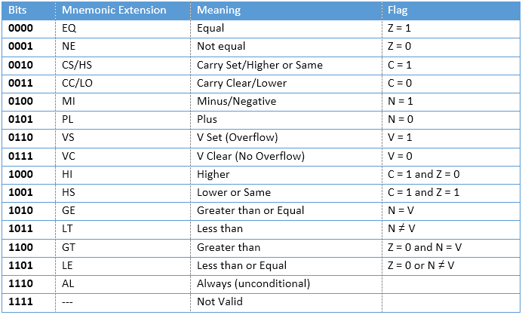
Conditional Execution
A unique feature of ARM
conditional execution for ALL instructions
Microprocessors and Assembly Language, Spring 2020, AUT, Tehran, Iran

Slide 15
Conditional Execution
Conditional MOV
MOV R1, #10; R1 = 10 MOV R2, #12; R2 = 12 CMP R2, R1; compare 12 with 10, Z=0 because they are not equal MOVEQ R4, #20; this line is not executed because the condition EQ is not met
Conditional ADD with ‘S’ suffix
ADDNES R1, R1, #10 ; this line is executed and set the flags if Z = 0
Microprocessors and Assembly Language, Spring 2020, AUT, Tehran, Iran

Slide 16
End of Chapter 4!
Microprocessors and Assembly Language, Spring 2020, AUT, Tehran, Iran

